Slide 1

Data Communication and Computer Network BLM3051
Dr. Öğr. Üyesi Furkan ÇAKMAK

Slide 2

Lecture Information Form - Weekly Subjects
BLM3051
Data Communication and Computer Network - 6
Hafta | Tarih | Konular
1 | 20.02.2024 | Introduction to Data Communication Standards Used on Data Communication, Architectural models
2 | 27.02.2024 | OSI Reference Model , Layers and Their Functions, Signaling and Signal Encoding
3 | 05.03.2024 | Parallel and Serial Transmission, Communication Media and Their Technical Specs., Multiplexing (TDM, FDM)
4 | 12.03.2024 | Error Detection and Error Correction Techniques, Data Link Control Techniques, Flow Control
5 | 19.03.2024 | Asynchronous and Synchronous Data Link Protocols (BSC, HDLC)
6 | 26.03.2024 | LAN Technologies Continued, IEEE 802.4, 802.5, 802.11
7 | 02.04.2024 | Connectionless and Connection Oriented Services, Switching
8 | 09.04.2024 | Tatil – Ramazan Bayramı Arifesi
9 | 16.04.2024 | 1. Ara Sınav
10 | 23.04.2024 | Tatil – 23 Nisan Ulusal Egemenlik ve Çocuk Bayramı
11 | 30.04.2024 | Static and Dynamic Routing, Congestion in the Network Layer, Its Causes and Solutions
12 | 07.05.2024 | IP (Internetworking Protocol), ICMP, BOOTP, DHCP
13 | 14.05.2024 | 2. Ara Sınav
14 | 21.05.2024 | UDP (User Datagram Protocol), TCP (Transmisson Control Protocol)
Dr. Öğr. Üyesi Furkan ÇAKMAK

Slide 3
LAN – Local Area Networks
BLM3051
Data Communication and Computer Network - 6
Multi-point mode
Basic models:
Ethernet - IEEE 802
Token Bus - IEEE 802
Token Ring - IEEE 802
FDDI/CDDI (Fiber/Copper Distributed Data Interface) - ANSI
WLAN (Wireless LAN) - IEEE 802
Data Link Layer is consist of HDLC
3 types of Media Access:
Fixed Based
TDMA, FDMA veya CDMA (Time/Frequency/Code Division Multiple Access)
Contention Based
Aloha, CMSA
Token/Reservation Based
Token Ring
Dr. Öğr. Üyesi Furkan ÇAKMAK
Notes:
Contention: Çekişmeli

Slide 4
IEEE 802 Project
BLM3051
Data Communication and Computer Network - 6
LANs
802.3 Ethernet
802.4 Token Bus
802.5 Token Ring
Wireless LANs
802.11 Wi-Fi
Wireless PANs
802.15 WPAN
802.15.1 BlueTooth
802.15.4 Zigbee
WANs
802.16 Wi-Max
Dr. Öğr. Üyesi Furkan ÇAKMAK
Notes:
Contention: Çekişmeli

Slide 5
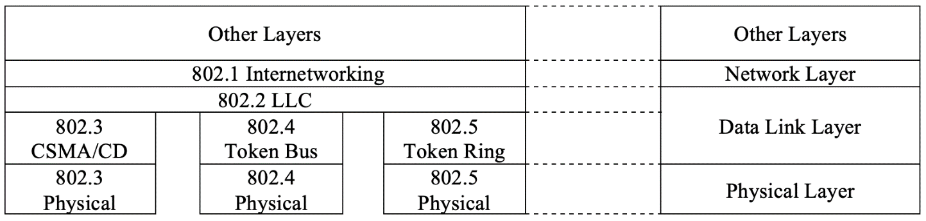
IEEE 802 Project – Con’t
BLM3051
Data Communication and Computer Network - 6
to ensure compatibility between protocols used in LANs
MAC (Media Access Control)
LLC (Logical Link Control)
Un-ack connectionless service
Connection mode sevice
Ack connectionless service
PDU (Protocol Data Unit)
in LLC
DSAP (Destination Service Access Point)
SSAP (Source Service Access Point)
Control Field
Information Field
Dr. Öğr. Üyesi Furkan ÇAKMAK
Notes:
Contention: Çekişmeli

Slide 6
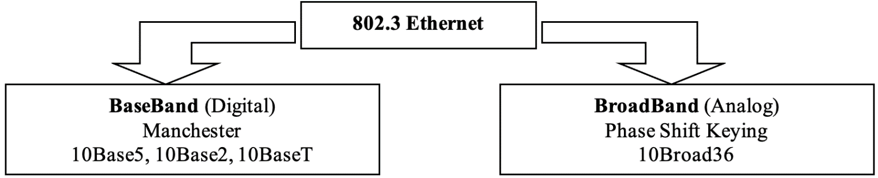
IEEE 802.3 Ethernet
BLM3051
Data Communication and Computer Network - 6
1972
Xerox Corp.
Aloha
Bob Metcalfe
1973
Hawaii Islands
Radio network
Collision?
Utility Rate: 18%
Slotted Aloha
Utility Rate: 37%
Dr. Öğr. Üyesi Furkan ÇAKMAK
Notes:
Contention: Çekişmeli

Slide 7
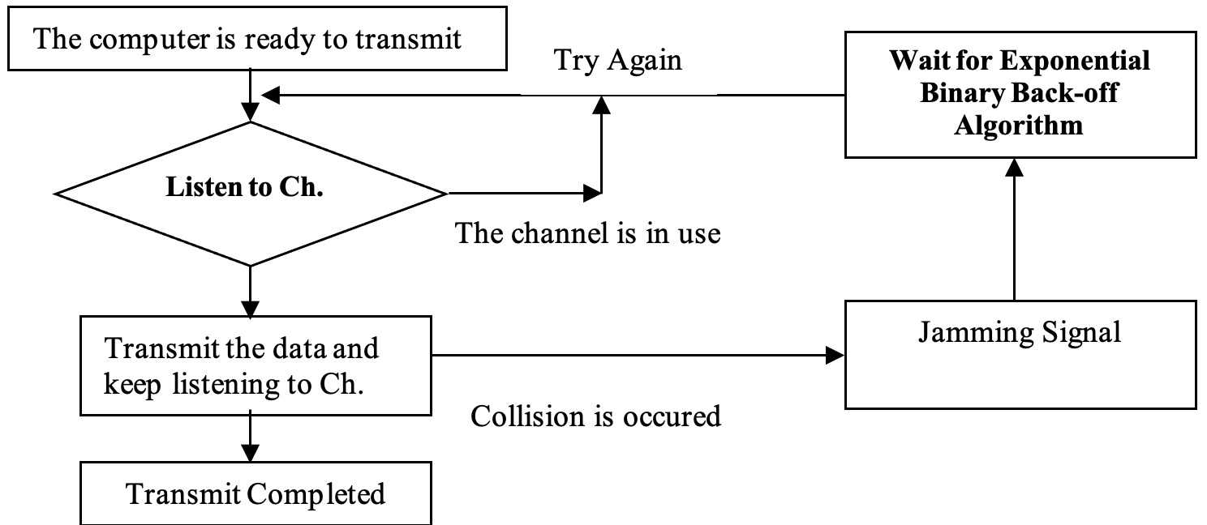
CSMA (Carrier Sense Multiple Access)
BLM3051
Data Communication and Computer Network - 6
The goal is to improve the Slotted Aloha.
Nonpersistent CSMA
1-Persistent CSMA
p-Persistent CSMA
CSMA/CD (Collision Detect)
Dr. Öğr. Üyesi Furkan ÇAKMAK
Notes:
Contention: Çekişmeli

Slide 8
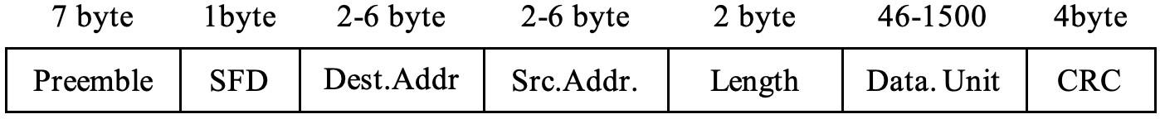
IEEE 802.3 Ethernet - Framing
BLM3051
Data Communication and Computer Network - 6
Preemble: 10101010
for sync.
SFD (Start of Frame Delimitter): 10101011
Shared and Switched Ethernet
Dr. Öğr. Üyesi Furkan ÇAKMAK
Notes:
Contention: Çekişmeli

Slide 9
IEEE 802.3 Ethernet Variations
BLM3051
Data Communication and Computer Network - 6
IEEE 802.3u - IEEE 802.3y - Fast Ethernet
10 Mbps -> 100 Mbps
Auto Negotiation
IEEE 802.3z - IEEE 802.3ab Gigabit Ethernet
Cat5/5e/6/7/8
100 Mbps -> 1000 Mbps
Auto Negotiation
IEEE 802.3ae – IEEE 802.3ak - IEEE 802.3an - IEEE 802.3aq - 10 GigE
1 Gbps -> 10 Gbps
IEEE 802.3ba – 40/100G Ethernet
40-100 Gbps
Dr. Öğr. Üyesi Furkan ÇAKMAK
Notes:
Contention: Çekişmeli

Slide 10
Metro Ethernet, Power over Ethernet (PoE)
BLM3051
Data Communication and Computer Network - 6
Dr. Öğr. Üyesi Furkan ÇAKMAK
Notes:
Contention: Çekişmeli

Slide 11
IEEE 802.4-Token Bus
BLM3051
Data Communication and Computer Network - 6
In worst case scenarios, some computers seem to wait too long to transmit.
General Motors
1980s
Bus and Tree Topology
Each computer recognizes the computers on its right and left.
After the logical ring is established, the computer with the highest number will transmit
Gives the control frame (Token) to its neighbor
Collision is impossible
New computers can be added or removed.
IEEE 802.4 MAC protocol is quite complex
Each computer included in the system must keep up to 10 different time information and
Evaluate approximately 24 status information.
75Ω Coaxial Cable
3 Different Modulation Techniques are used
Phase continious frequency shift keying
Phase coherent frequency shift keying
Multilevel duobinary amplitude modulated shift keying
Max speeds: 1,5 ve 10 Mbps
Dr. Öğr. Üyesi Furkan ÇAKMAK

Slide 12
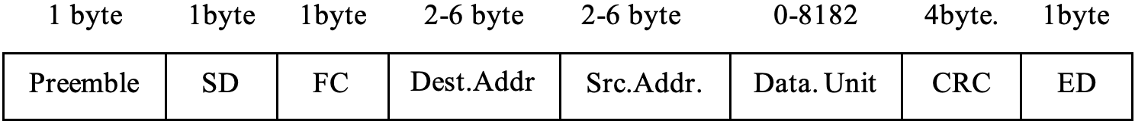
IEEE 802.4-Token Bus - Framing
BLM3051
Data Communication and Computer Network - 6
SD: Starting Delimitter
FC: Frame Control
ED: Ending Delimitter
Frame size is almost 5 times bigger than 802.3.
Priority mechanism:
4 levels priority: 0, 2, 4, 6
Dr. Öğr. Üyesi Furkan ÇAKMAK

Slide 13
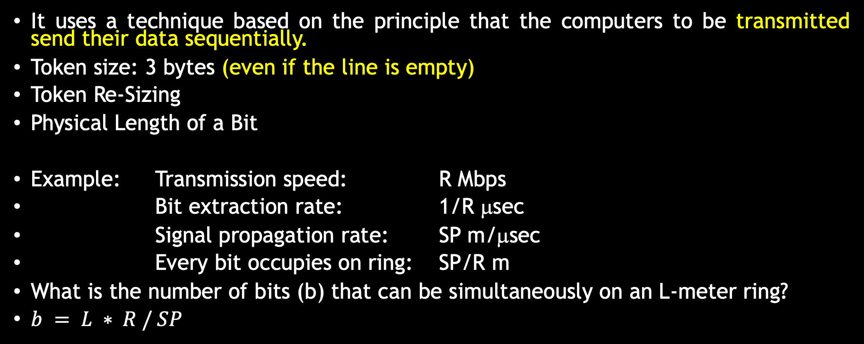
IEEE 802.5-Token Ring
BLM3051
Data Communication and Computer Network - 6
It uses a technique based on the principle that the computers to be transmitted send their data sequentially.
Token size: 3 bytes (even if the line is empty)
Token Re-Sizing
Physical Length of a Bit
Example: Transmission speed: R Mbps
Bit extraction rate: 1/R μsec
Signal propagation rate: SP m/μsec
Every bit occupies on ring: SP/R m
What is the number of bits (b) that can be simultaneously on an L-meter ring?
$b = L ∗ R / SP$
Dr. Öğr. Üyesi Furkan ÇAKMAK

Slide 14
IEEE 802.5-Token Ring - Priority and Reservation
BLM3051
Data Communication and Computer Network - 6
For reservation: AC (Access Control) is used.
Time Limitation
Monitor Station
No Token Frame
Orphan Frame
Dr. Öğr. Üyesi Furkan ÇAKMAK

Slide 15
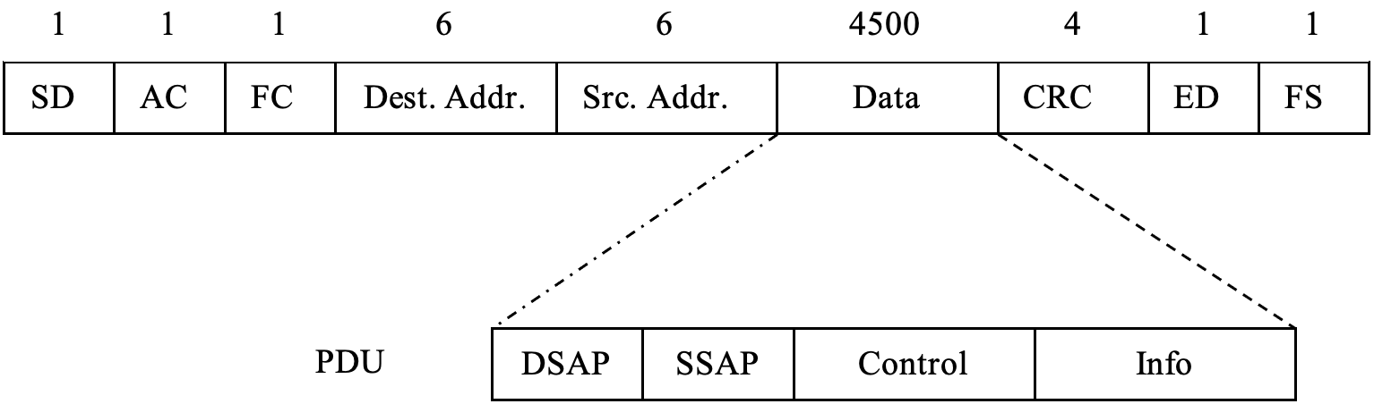
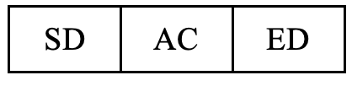
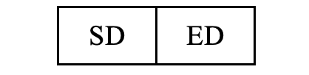
IEEE 802.5-Token Ring - Framing
BLM3051
Data Communication and Computer Network - 6
NIC (Network Interface Card) Addresses (6-byte)
Differential Manchester Coding
Max speeds are 4 and 16 Mbps (IEEE 802.5t: 100 Mbps, IEEE 802.5v: 1 Gbps)
First sending bit is MSB (different from 802.3 and 802.4)
Token
Abort
Dr. Öğr. Üyesi Furkan ÇAKMAK

Slide 16
FDDI (Fiber Distributed Data Interface)
BLM3051
Data Communication and Computer Network - 6
ANSI and ITU-U standart
Fiber optics: 100 Mbps
Token
S-Frame (Synchronous Frame) - priority
A-Frame (Asynchronous Frame)
Timing Register
SA (Synch. Allocation)
TTRT (Target Token Rotation Time)
AMT (Absolute Maximum Time)
TRT (Token Rotation Timer)
THT (Token Holding Time)
Dr. Öğr. Üyesi Furkan ÇAKMAK

Slide 17
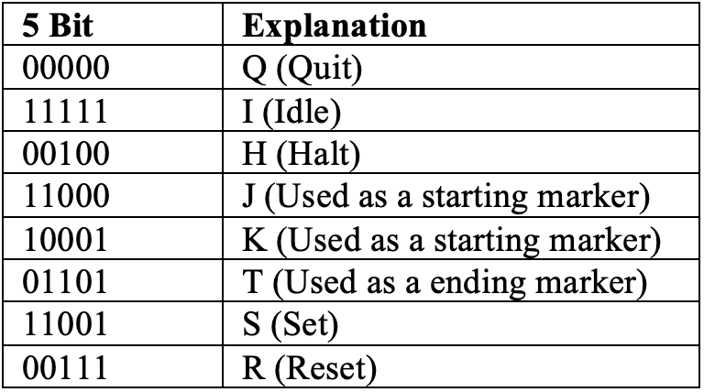
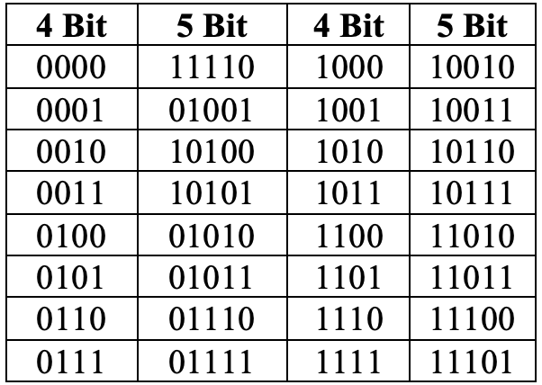
FDDI (Fiber Distributed Data Interface) – Con’t
BLM3051
Data Communication and Computer Network - 6
4B/5B Coding
Using NRZ-I
Dr. Öğr. Üyesi Furkan ÇAKMAK

Slide 18
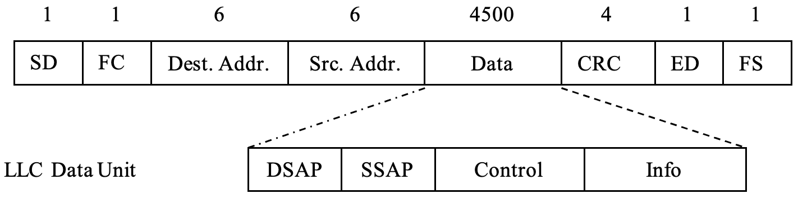

FDDI – Framing
BLM3051
Data Communication and Computer Network - 6
Dr. Öğr. Üyesi Furkan ÇAKMAK

Slide 19
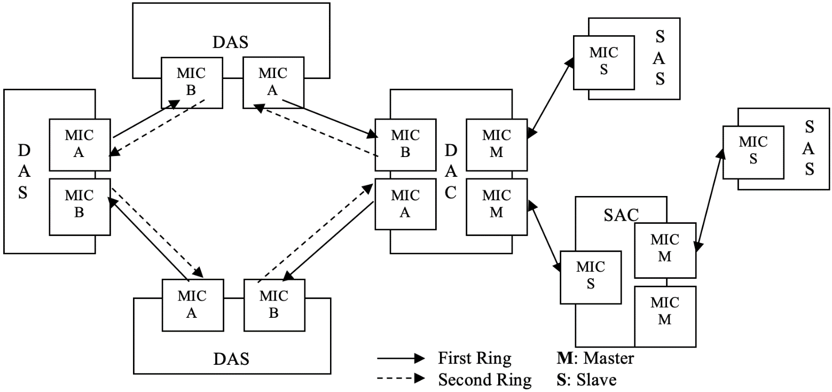
FDDI – Mechanism
BLM3051
Data Communication and Computer Network - 6
Dr. Öğr. Üyesi Furkan ÇAKMAK

Slide 20
IEEE 802.11 - WiFi
BLM3051
Data Communication and Computer Network - 6
RF
Infrared
Static
Mobile, Nomadic
Roaming
Carrier
Non-Line-of-Sight Propagation (NLSP)
Dr. Öğr. Üyesi Furkan ÇAKMAK

Slide 21
IEEE 802.11 – WiFi – Con’t
BLM3051
Data Communication and Computer Network - 6
Continuation of the Ethernet
CSMA/CD -> CSMA/CA (Carrier Sense Multiple Access/Collision Avoidance)
Antenna type: half-duplex
Fading
The signal decreases inversely with the square of the distance
Noise
Detecting collisions is almost impossible
IEEE 802.11 MAC
DCF (Distributed Coordination Function)
CMSA/CA
PCF (Point Coordination Function)
Polling
Dr. Öğr. Üyesi Furkan ÇAKMAK

Slide 22
IEEE 802.11 – DCF-Distributed Coordination Function
BLM3051
Data Communication and Computer Network - 6
DCF basic access method
Checks if the line is empty
If it sees that the line is empty for DIFS (DCF Inter-Frame Space) time, it switches to transmission.
If the line is busy, it delays its own transmission until the transmission is finished.
Waits until DIFS (back-off) times is up
The back-off timer starts to decrease (DIFS)
It transmits when the back-off time value is 0.
Timing slots
Receiving node sends acknowledgment (ACK) after waiting the time specified by SIFS (Short Inter Frame Space).
SIFS<DIFS
In case a collision;
EIFS (Extended Inter Frame Space)
Dr. Öğr. Üyesi Furkan ÇAKMAK

Slide 23
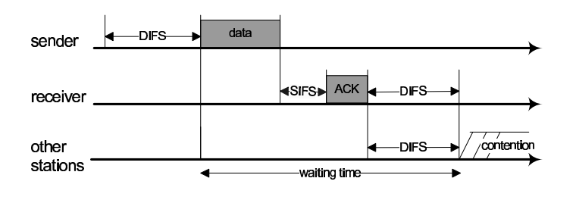
IEEE 802.11 – DCF-Distributed Coordination Function – Con’t
BLM3051
Data Communication and Computer Network - 6
Dr. Öğr. Üyesi Furkan ÇAKMAK

Slide 24
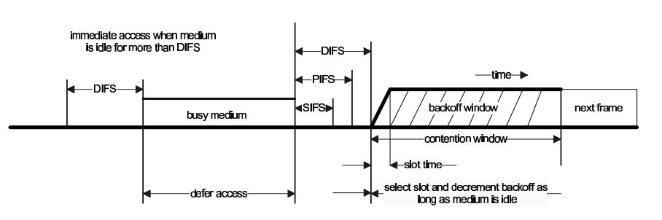
IEEE 802.11 – DCF-Distributed Coordination Function – Con’t
BLM3051
Data Communication and Computer Network - 6
Dr. Öğr. Üyesi Furkan ÇAKMAK

Slide 25
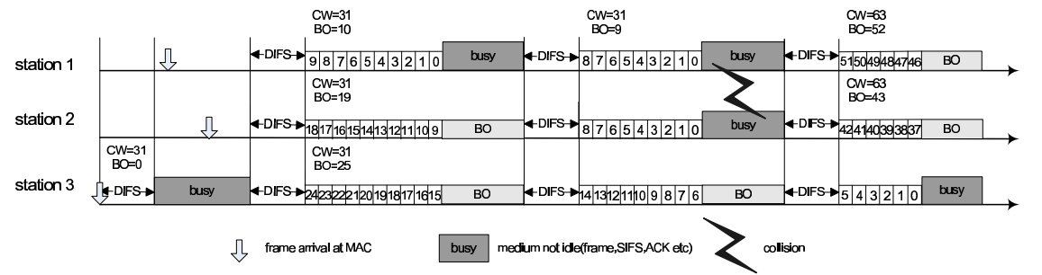
IEEE 802.11 – DCF-Distributed Coordination Function – Con’t
BLM3051
Data Communication and Computer Network - 6
Dr. Öğr. Üyesi Furkan ÇAKMAK

Slide 26
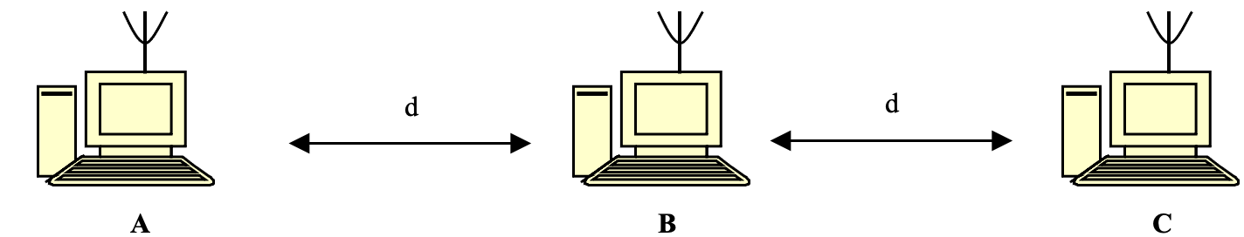
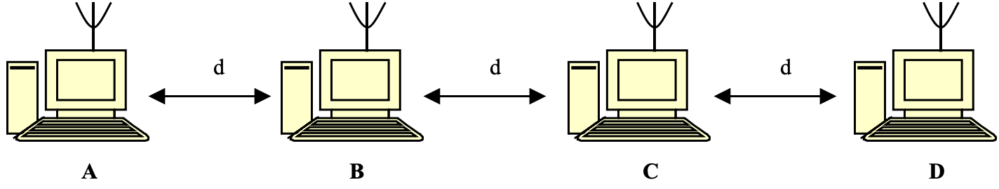
IEEE 802.11 – DCF-Distributed Coordination Function – Con’t
BLM3051
Data Communication and Computer Network - 6
RTS (Request To Send) / CTS (Clear To Send)
NAV (Network Allocation Vector)
Hidden Node
Exposed Node
Dr. Öğr. Üyesi Furkan ÇAKMAK

Slide 27
Service Area
BLM3051
Data Communication and Computer Network - 6
BSA - Basic Service Area
ESA - Extended Service Area
Wired Distributed System
Dr. Öğr. Üyesi Furkan ÇAKMAK

Slide 28
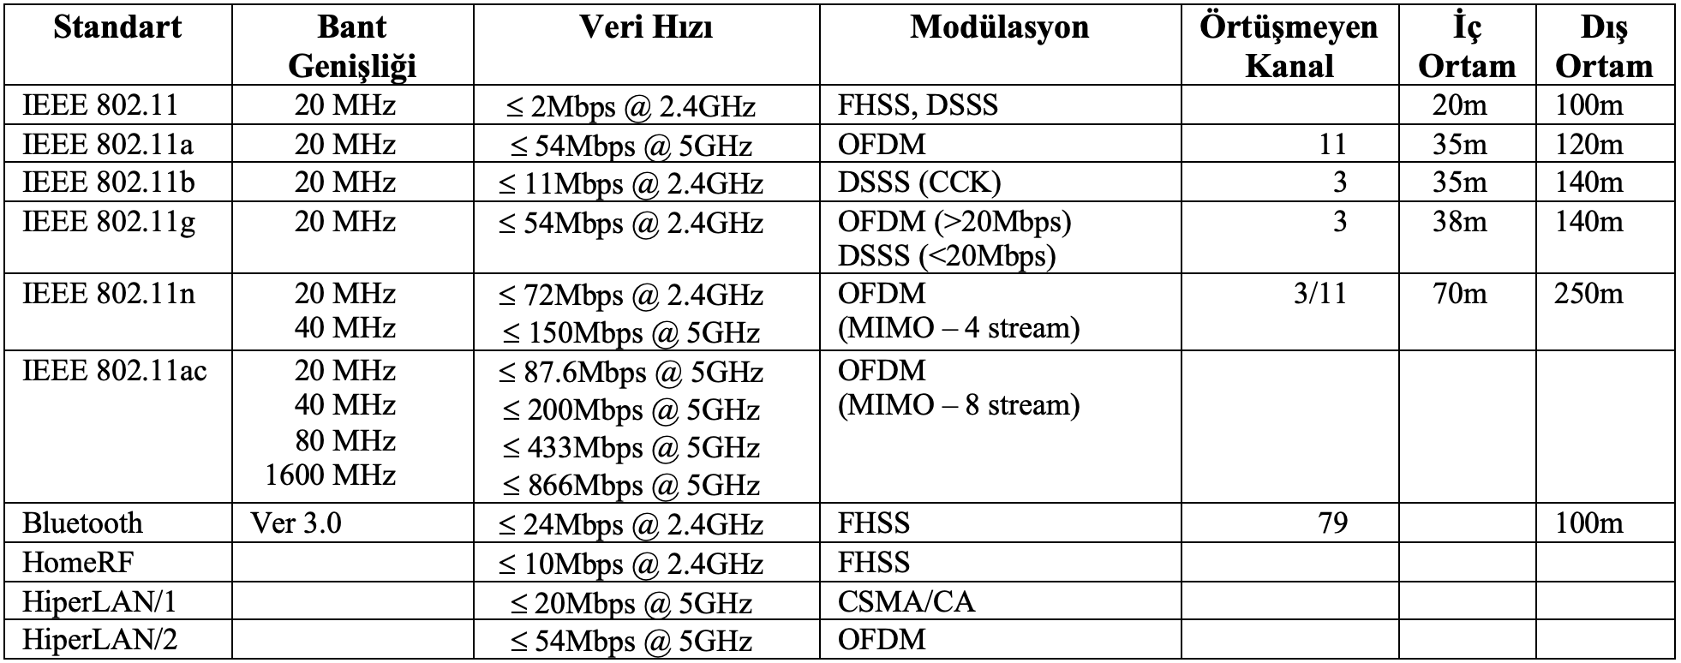
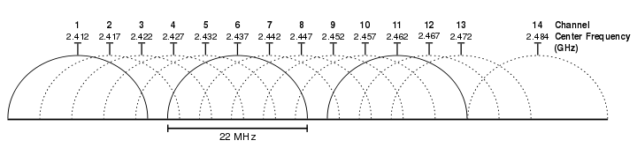
Channel Usage
BLM3051
Data Communication and Computer Network - 6
2.4000–2.4835 GHz
5 MHz
13-15 Channels
Spread-Spectrum
FHSS - Frequency-Hopping Spread Spectrum
DSSS - Direct-Sequence Spread Spectrum
Dr. Öğr. Üyesi Furkan ÇAKMAK

Slide 29
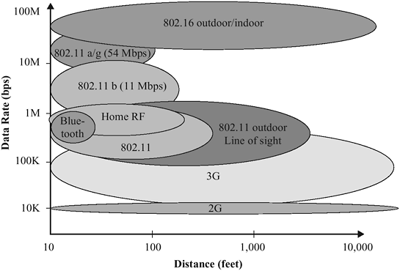
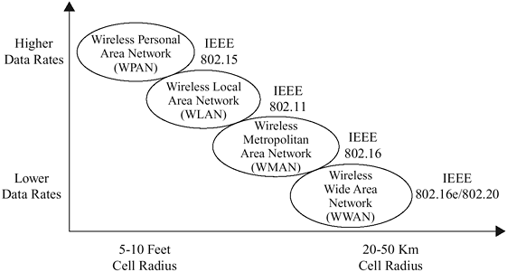
Channel Usage – Con’t
BLM3051
Data Communication and Computer Network - 6
Dr. Öğr. Üyesi Furkan ÇAKMAK

Slide 30
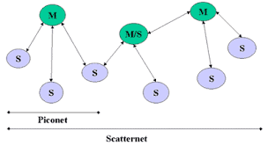
Other WiFi Standarts
BLM3051
Data Communication and Computer Network - 6
BT (Bluetooth) – IEEE 802.15.1
1994
Ericsson
Bluetooth Special Interest Group (SIG)
2.45 GHz (2.402-2.480 GHz)
SSFH (Spread-Spectrum Frequency Hopping)
10-100m
24 Mbps
Piconet
Scatternet
Zigbee – IEEE 802.15.4
HomeRF
HiperLAN
Dr. Öğr. Üyesi Furkan ÇAKMAK

Slide 31
Threats for Wireless Networks
BLM3051
Data Communication and Computer Network - 6
Eavesdropping
Unauthorization Access
Intruder
Sending message
Receiving message
Changing message
Forging message
Compromised
Authentication
Credential
Intrusion detection
Interference, Jamming
Denial of service attack
Physical threats
Dr. Öğr. Üyesi Furkan ÇAKMAK

Slide 32
Security in Wireless Networks
BLM3051
Data Communication and Computer Network - 6
Authentication
Encryption
Security types
Wired Equivalent Privacy (WEP)
Encryption only for data, not for header
RC4
Encryption key is too weak.
Wi-Fi Protected Access (WPA)
>= 2003
Temporal Key Integrity Protocol (TKIP)
Authentication
WPA2 (2010)
Advanced Encryption Standard (AES)
Extensible Authentication Protocol (EAP)
2008 -> TKIP is unreliable
Dr. Öğr. Üyesi Furkan ÇAKMAK

Slide 33
Comprasion of LANs
802.3 Ethernet | Yaygın kullanım, sahip olunmuş deneyim Basit algoritma Basit kurulum. Yıldız ilingesinde yeni bir bilgisayar eklemek ağın çalışmasını etkilemez. Sayısal işaretleşme (Manchester) LSB öncelikli veri iletimi Düşük yüklerde gecikme sıfıra yakındır
 | CD donanımı örneksel Yüklü çalışma durumunda veri bozulması (collision) olasılığı artar Non deterministic (Gerçek zamanlı uygulamalar için ideal değil) Öncelik mekanizması mevcut değil En az 64’byte’lik çerçeveler Sınırlı çerçeve büyüklüğü
802.4 Token Bus | Deterministic Öncelik mekanizması (garanti edilmiş bant genişliği) Yüklü çalışmada mükemmel sonuç Birden fazla kanal üzerinden iletim imkânı (örneksel)
 | Örneksel yapı (modem, amplifier vs.) Son derece karmaşık protokol yapısı Düşük yüklerde gecikmeler artıyor Fiber kullanımına müsait değil
802.5 Token Ring | Sayısal işaretleşme (Differential Manchester) MSB öncelikli veri transferi Öncelik mekanizması ve 8 seviye Rezervasyon imkânı Yüklü çalışmada yüksek verim İletim ortamındaki çeşitlilik Kısa ve uzun çerçeve yapıları kullanabilir. Deterministic
 | Monitör fonksiyonu Düşük yüklerde jeton iletiminde yaşanan gecikmeler
FDDI | Zamana duyarlı veri iletimine öncelik verilmiştir. Çift halka kullanımı dolayısıyla çalışma süreklilik vardır. Fiber kullanımı ile kapsadığı mesafe arttırılmıştır
 | Hız olarak ihtiyaçların gerisinde kalmak üzeredir.
WLAN | Mobil olma kavramını getirmiştir Fiziksel olarak kablo çekmenin mümkün olmadığı yerlerde son derece tatminkâr sonuçlar üretir.
 | Sınırlı mesafe içinde çalışmaktadır. Kablolu ağlara nazaran iletişim hızları düşüktür. İletim ortamı olarak havanın kullanılması nedeniyle EMI’ye açıktır
BLM3051
Data Communication and Computer Network - 6
Dr. Öğr. Üyesi Furkan ÇAKMAK

Slide 34
Thank you for your listening.
BLM3051
Data Communication and Computer Network - 6
Dr. Öğr. Üyesi Furkan ÇAKMAK

